Slide 1

Intro to Bayesian Statistics Sarah Pederzani StalFire PSM workshop, University of Utah 17.01.2025

Slide 2


Statistics as a tool for science
What can say about the world from some data that I have collected?
Statistical inference = drawing conclusions from data using knowledge of probability
Based on my
observations, I conclude
that this barrel is leaking
a toxic substance!

Slide 3

What are probabilities?

Slide 4

Probability is counting
What is the proportion of water on the globe?
For each proportion of water:
Count all the possible ways my sample could happen
Proportions with more ways to produce my sample are more plausible

Slide 5
A four-sided globe
D4 with 25% water
1
2
1
3
1
4

Slide 6
Probability is counting
Possible ways of seeing W, L, W with a 25% water D4 globe
We observed W, L, W
How plausible are different proportions of water?
Possible proportions of water
1.
2.
3.
4.
5.

Slide 7
Probability is counting
Possible ways of seeing W, L, W with a 25% water D4 globe
We observed W, L, W
How plausible are different proportions of water?
Possible proportions of water
1.
2.
3.
4.
5.

Slide 8
Probability is counting
Possible ways of seeing W, L, W with a 25% water D4 globe
We observed W, L, W
How plausible are different proportions of water?
Possible proportions of water
1.
2.
3.
4.
5.

Slide 9
Probability is counting
Possible ways of seeing W, L, W with a 25% water D4 globe
We observed W, L, W
How plausible are different proportions of water?
Possible proportions of water
1.
2.
3.
4.
5.

Slide 10
Probability is counting
We observed W, L, W
Possible ways of seeing W, L, W with a 25% water D4 globe
How plausible are different proportions of water?
Possible D4 globes
ways to see W, L, W
1.
0
2.
3
3 ways to see W, L, W
3.
8
4.
9
75% water most plausible given our data
5.
0

Slide 11
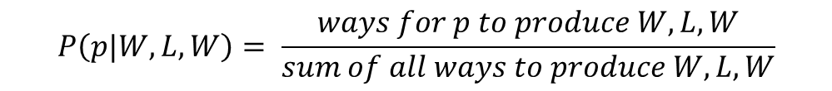
Probability
Things that can happen more ways are more plausible
Probabilities are ways to express our counting in a normalized way
Probabilities = non-negative values that sum to 1
Possible D4 globes
ways to see W, L, W
Probability
1.
0
0
2.
3
0.15
3.
8
0.40
4.
9
0.45
5.
0
0
$$P\left(p|W,L,W\right)= \frac{ways for p to produce W,L,W}{sum of all ways to produce W, L,W}$$
Divide by 20
^{(sum of ways to see W,L,W)}

Slide 12
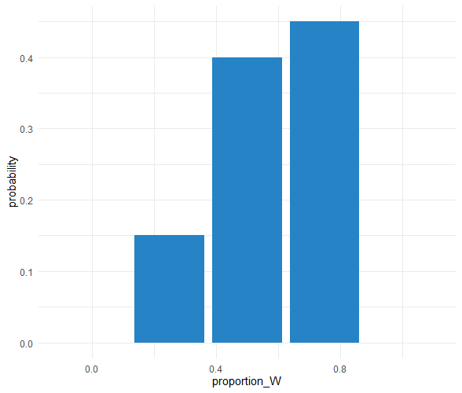
Probability distributions
Possible D4 globes
Probability
Probability distribution
1.
0
2.
0.15
3.
0.40
4.
0.45
5.
0
A list of the probabilities of all possible outcomes

Slide 13
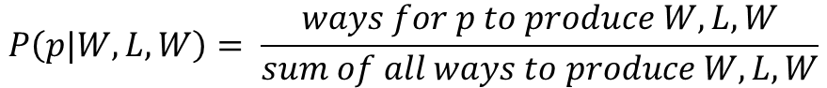
The globe is a die with infinite sides
We observed W, L, W
$$P\left(p|W,L,W\right)= \frac{ways for p to produce W,L,W}{sum of all ways to produce W, L,W}$$
1
4
In D4 globe world
A round globe = an infinite-sided die
The counting math quickly becomes less tractable
Maybe we want to look at some problems that are less easy to translate into manual counting
$$ways for p to produce W,L,W={(4p)}^{W}∙ {(4−4p)}^{L}$$
W = number of water observations
L = number of land observations
$$ways p to produce W,L,W={(n∙p)}^{W}∙ {(n−n∙p)}^{L}$$
n = number of sides on the dice

Slide 14

Bayesian statistics = a better way to count

Slide 15
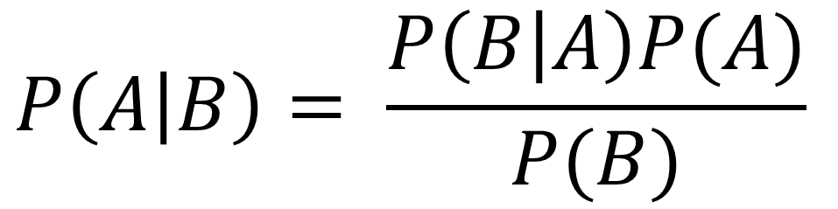
Thomas Bayes & Bayes’ Theorem
Thomas Bayes, “An essay towards solving a problem on the doctrine of chances” (1763)
Presents a solution to a problem of inverse probability
$$P\left(A | B\right)= \frac{P\left(B | A\right)P(A)}{P(B)}$$
The probability of A given B
Probability of unobserved A given observation of B
Interpretations of Bayes’ Theorem form the basis for Bayesian statistical methods

Slide 16
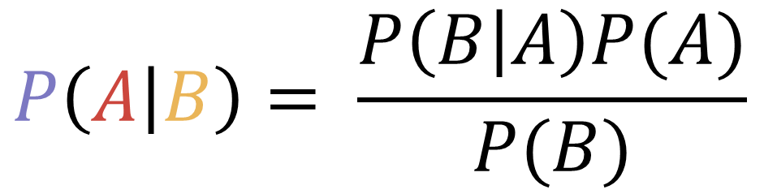
Bayesian reasoning
Quantities are divided into observed data and unobserved parameters
We use Bayes’ Theorem to calculate the probability of the unobserved given the observed
→ the posterior probability
$$P\left(A | B\right)= \frac{P\left(B | A\right)P(A)}{P(B)}$$
Observed
=
Data
Posterior probability
=
Probability unobserved | observed
Bayes’ Theorem
Unobserved
=
Parameters

Slide 17
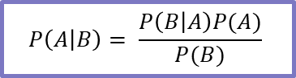
Back to our globe
$$P\left(A | B\right)= \frac{P\left(B | A\right)P(A)}{P(B)}$$
P of given proportion of water
P of proportion of water
x
P of proportion of water given
=
All ways to see
across all water proportions
Bayes theorem is just a mathy way to describe our counting!

Slide 18

Another example
Dear eminent Professor,
We are contacting you due to your exceptional contributions to the field of isotope. The Journal of isotope is a highly regarded and prestigious publication. We cordially invite you to submit your valuable manuscript and await your answer imminently.

Slide 19
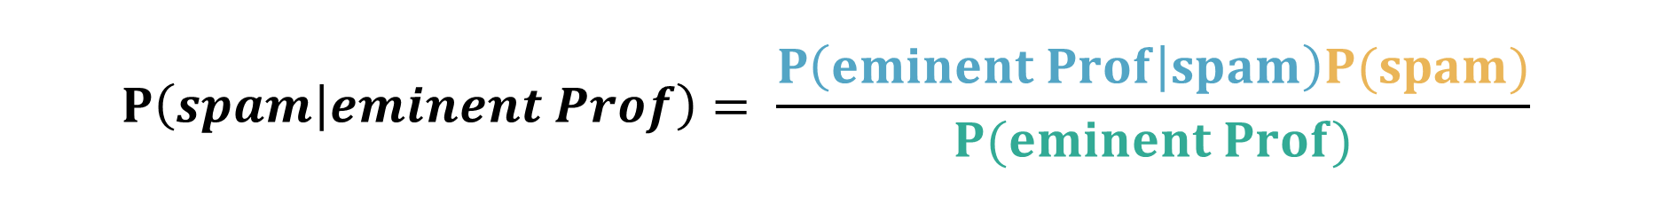
Is this Email spam?
If deciding an email is spam we often scan for particular features or keywords
E.g. addresses the recipient as “Dear eminent Professor”
What is the probability that an email is spam if it contains “Dear eminent Professor”?
P of “eminent Prof” in spam emails
P of receiving spam
$$P\left(spam | eminent Prof\right)= \frac{P\left(eminent Prof | spam\right)P(spam)}{P(eminent Prof)}$$
P of spam given “eminent Prof”
P of “eminent Prof” in any email

Slide 20
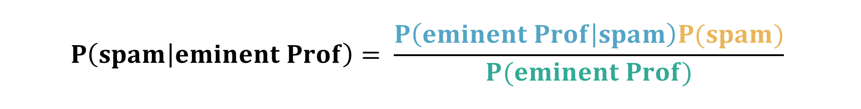
Is this Email Spam
Much but not all spam includes eminent prof
I get a lot of spam
Likelihood of data
(given parameters)
Prior information
$$P\left(spam | eminent Prof\right)= \frac{P\left(eminent Prof | spam\right)P(spam)}{P(eminent Prof)}$$
New knowledge
Uniqueness of evidence
Eminent prof is rare in other emails

Slide 21
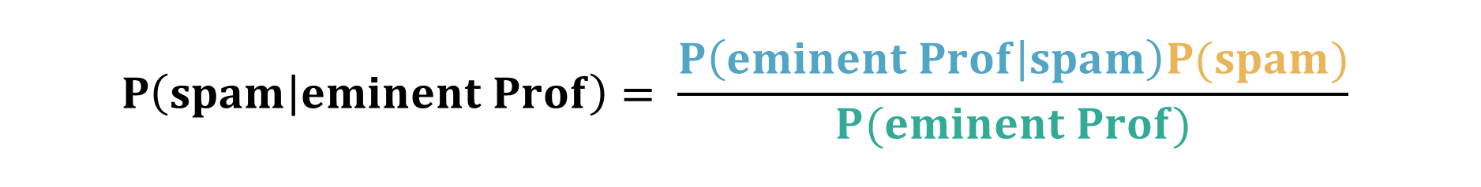
Translating into Bayesian jargon
Likelihood
Prior
$$P\left(spam | eminent Prof\right)= \frac{P\left(eminent Prof | spam\right)P(spam)}{P(eminent Prof)}$$
Posterior
Normalizing
constant
Posterior ∝ Likelihood x Prior

Slide 22

Bayes in practice

Slide 23
Building blocks for Bayesian inference
Bayesian inference
Known data → unknown parameters
Data
Known observations
Generative model
known parameters → unknown data
Priors
information about parameters before seeing data
Model of how data could happen
=
Likelihood function

Slide 24
What does a model look like?
model {
# likelihood
for(i in 1:N){
y ~ dnorm(slope * x + intercept, residual_sd^-2)
}
# priors
intercept ~ dnorm(4, 1^-2)
slope ~ dnorm(0.8, 0.1^-2)
residual_sd ~ dnorm(0.2, 0.02^-2)
}
Generative model
Priors

Slide 25
The likelihood
Generative model
(forward model)
known parameters → unknown data
A mathematical representation of how we think our data could happen
Probability of the data given the parameters
We will learn more about generative models tomorrow!

Slide 26
Priors
Prior
Likelihood
Posterior
Priors
information about parameters before seeing data
We choose prior distributions to convey
Knowledge about the value of a parameter
The certainty of this knowledge
More on choosing prior distributions later…

Slide 27
The posterior probability distribution
New knowledge
Known data → unknown parameters
Probability distribution
In reality, we usually have multiple parameters of interest
We obtain a complex, multidimensional posterior
A list of the probabilities of all possible outcomes

Slide 28
Changing perspective from Frequentism

Slide 29
Advantages of Bayesian methods
The statistics wars are over, but there are pragmatic advantages for scientific problems
Estimate with uncertainty
Less data restrictions
Make use of all information
Easy to obtain parameter estimates for quantities of interest
We obtain information about the level of confidence of the estimate
We can identify and remedy areas of high uncertainty in our model
No minimum sample size
(but garbage in, garbage out remains true)
No assumptions about data distribution, no normality requirements
Measurement error and missing data very easy to account for
We learn from the data directly
Data can be added incrementally, no p-hacking issues
We almost always have some prior information!

Slide 30
Frequentist vs Bayesian thinking
Frequentist
Bayesian
a long-term relative frequency | expresses a belief about the world after observing some data
fixed point values | distributions
the structure of the data determines the statistical approach | no data structure assumptions or requirements
Probability
Parameters
Data

Slide 31
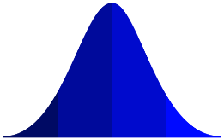
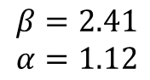
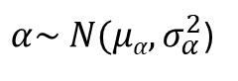
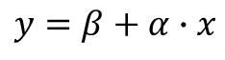
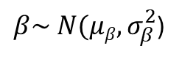
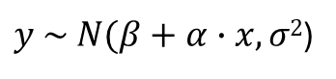
A linear model as an example
Frequentist linear regression
Bayesian linear regression
Fixed parameters
Parameter distributions
$$y=β+α∙x$$
$y \sim N(β+α∙x, σ2$)
y
y
x
x
$β\sim N(μβ, σ_{β}^{2}$)
$α\sim N(μα, σ_{α}^{2}$)
$$β=2.41$$
$$α=1.12$$

Slide 32

Time for a break

Slide 33

Choosing priors?

Slide 34
Choosing prior distributions
How strong should the impact of my prior knowledge be?
Informative priors
Weakly informative priors
Uninformative priors
Reflect best estimate of the statistician’s knowledge about model parameters
Distribution is adjusted to the somewhat subjective level of uncertainty of this knowledge
A compromise of not adding too much external information while also preventing overfitting to some extent
Has minimal influence on the posterior
Criticism: not actually uninformative
→ flat priors can exert strong influences in some cases
Danger of overfitting to the data
Some statistical movements are weary of the subjective nature of choosing informative priors
Sensitivity analyses should always be used to examine the effects of priors

Slide 35
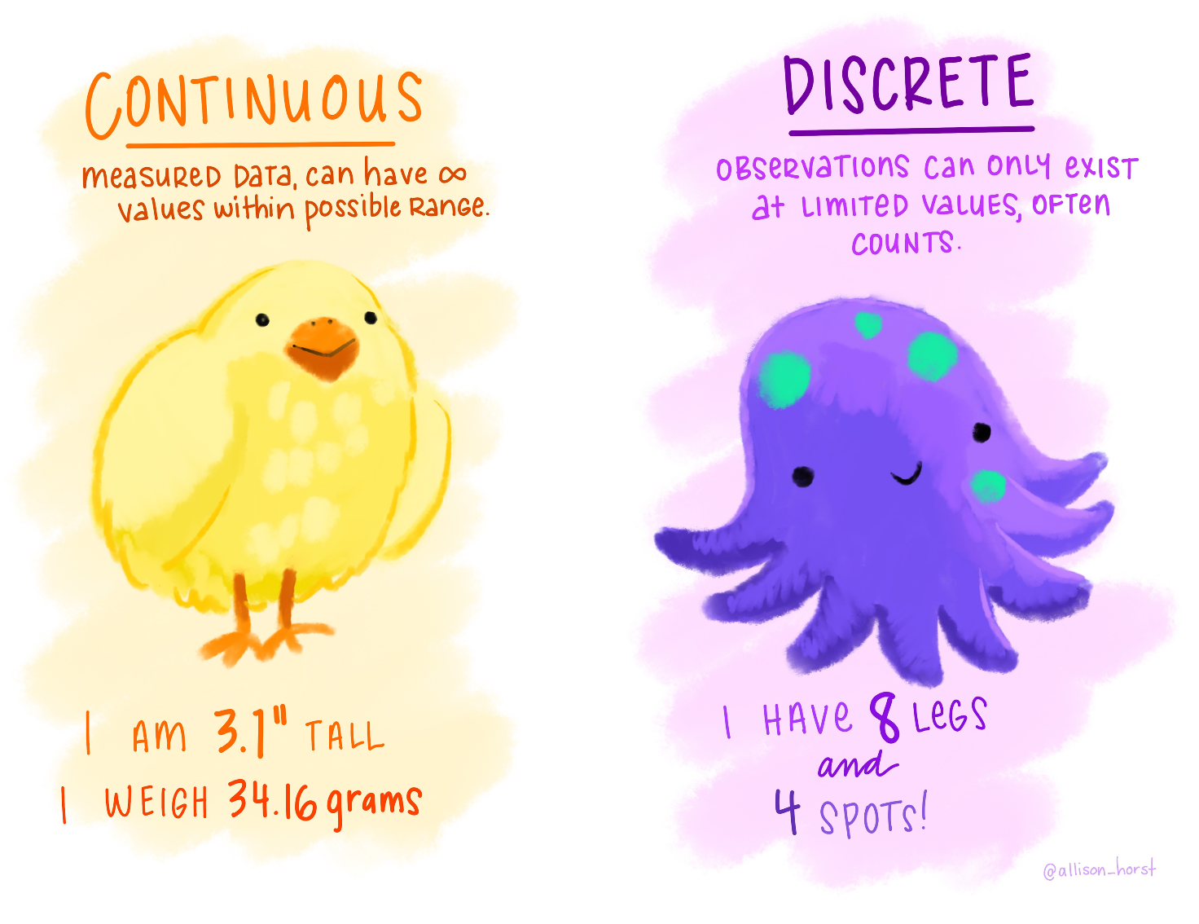
Types of distributions
Artwork by Allison Horst

Slide 36
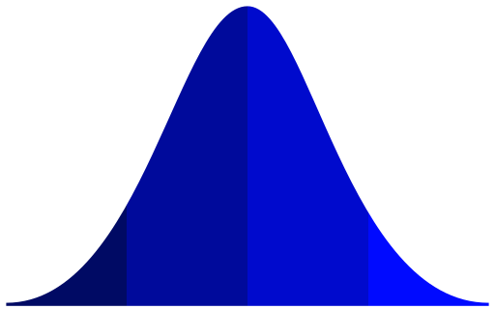
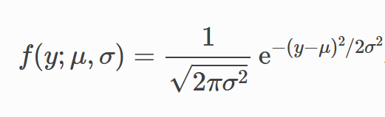
The Normal distribution
Quantities emerging from sums of many subprocesses are often normally distributed
Features
Typical use cases
Univariate continuous
Symmetrical
Long, thin tails
Measurement error
Biological measurements
„random noise“
Parameters
Mean: μ - peak location
SD: σ – peak width

Slide 37
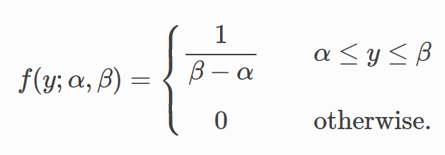
The Uniform distribution
Outcomes restricted to a defined range where every outcome has equal probability
Features
Typical use cases
Univariate continuous
Flat between two bounds
A special case of the Beta distribution
„uninformative“ priors
Parameters
Interval: [α, β]

Slide 38
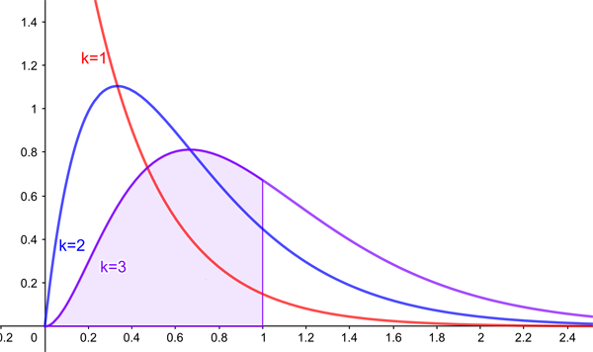
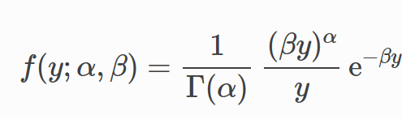
The Gamma distribution
Produced by multistep processes where each process happens at the same rate
Features
Typical use cases
Univariate continuous
Only non-negative values
skewed
produces mounded and exponential distributions
α < 1 : exponential shape, asymptotic to both axes
α = 1: exponential distribution
α > 1 : mounded shape
priors for parameters we know can‘t be negative
Often used for modeling time between events
Parameters
Shape: α - mounded or exponential
Scale: β - width of the distribution

Slide 39
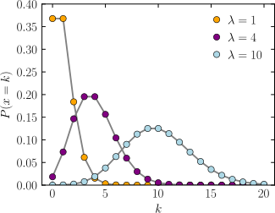
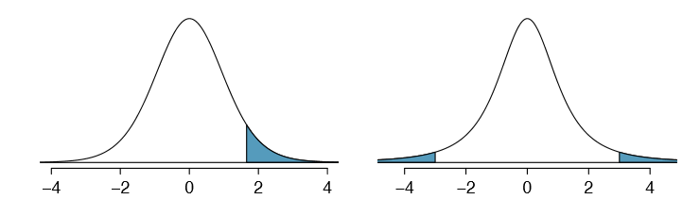
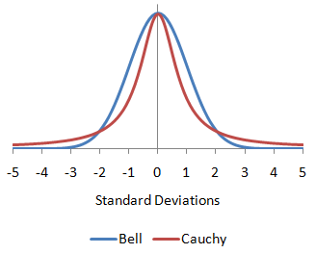
Other useful distributions
Poisson
Student’s t
Cauchy
Discrete distribution of counts
Similar to the Normal distribution but with more mass in the tails
Even heavier tails
Student’s t
Normal
Many more distributions are used in Bayesian statistics, but these will get you started

Slide 40

Obtaining the posterior

Slide 41
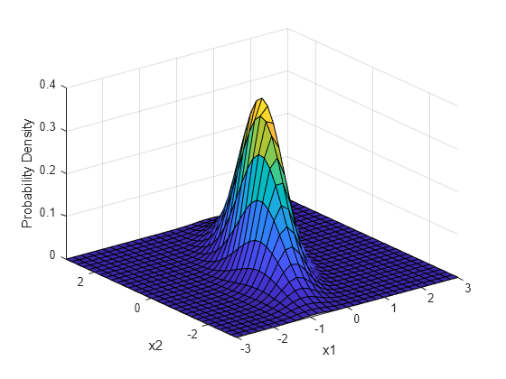
How to obtain the posterior?
Analytical approaches to calculate the exact posterior distribution are usually impossible
Posterior distributions are often multidimensional and likelihood and normalizing constants are highly complex
We need to approximate using computational algorithms
Markov Chain Monte Carlo

Slide 42


Markov Chain Monte Carlo
Smaug has several cave rooms filled with treasure
He needs to protect his treasure from Hobbits & Dwarves
He wants to sleep on the treasure heaps in proportion to their size

Slide 43

Smaukov Chain Monte Carlo
Here is how he does it
1/2
1/2
1. Flip a coin to choose the treasure pile to the left or to the right.
Call it the “proposal pile”

Slide 44
Smaukov Chain Monte Carlo
1. Flip a coin to choose the treasure pile to the left or to the right.
Call it the “proposal pile”
proposal
1
2
3
4
5
S₃
2. Find the size of the proposal treasure pile S₃

Slide 45
Smaukov Chain Monte Carlo
1. Flip a coin to choose the treasure pile to the left or to the right.
Call it the “proposal pile”
2. Find the size of the proposal treasure pile S₃
proposal
1
2
3
4
5
S₂
S₃
3. Find the size of the current treasure pile S₂

Slide 46
Smaukov Chain Monte Carlo
1. Flip a coin to choose the treasure pile to the left or to the right.
Call it the “proposal pile”
2. Find the size of the proposal treasure pile S₃
3. Find the size of the current treasure pile S₂
proposal
1
2
3
4
5
S₂
S₃
4. Move to proposal pile with probability = S₃/S₂

Slide 47
Smaukov Chain Monte Carlo
1. Flip a coin to choose the treasure pile to the left or to the right.
Call it the “proposal pile”
2. Find the size of the proposal treasure pile S₃
3. Find the size of the current treasure pile S₂
4. Move to proposal pile with probability = S₃/S₂
1
2
3
4
5
S₂
S₃
5. Repeat from start

Slide 48
Smaukov Chain Monte Carlo
1. Flip a coin to choose the treasure pile to the left or to the right.
Call it the “proposal pile”
2. Find the size of the proposal treasure pile S₃
3. Find the size of the current treasure pile S₂
4. Move to proposal pile with probability = S₃/S₂
5. Repeat from start
1
2
3
4
5
S₂
S₃
In the long run this method ensures that Smaug sleeps on each pile in proportion to the pile size

Slide 49


Markov Chain Monte Carlo
Drawing values from the posterior to approximate it
Treasure piles = parameter values
Parameter guesses made in sequence
sequences = “chains”
New guesses only depend on immediately preceding guess
(Markov property)
Pile size = posterior probability
With an increasingly large number of samples our chains will over time converge on the target distribution – the true posterior probability distribution

Slide 50
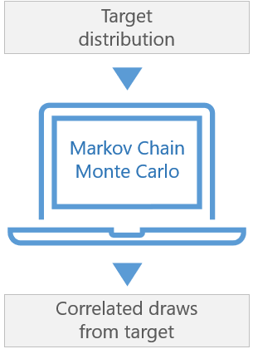
MCMC algorithms
There are many different methods for drawing samples from the posterior
They are called sampling algorithms or samplers
Popular samplers include Metropolis-Hastings, Gibbs, Hamiltonian
Our program JAGS uses a Gibbs sampler (JAGS = Just Another Gibbs Sampler)
Hamiltonian samplers (e.g. NUTS in the Stan program) are better at exploring multi-modal distributions

Slide 51
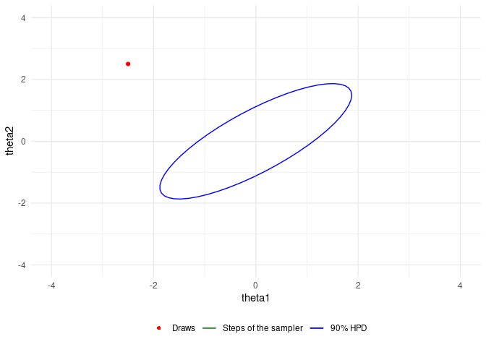
Gibbs sampling visualized

Slide 52
Is my model any good?

Slide 53

How do I know my MCMC is working well?
We want to make sure we obtain a robust approximation of the posterior
We can ensure this by choosing model specs and running diagnostic checks

Slide 54
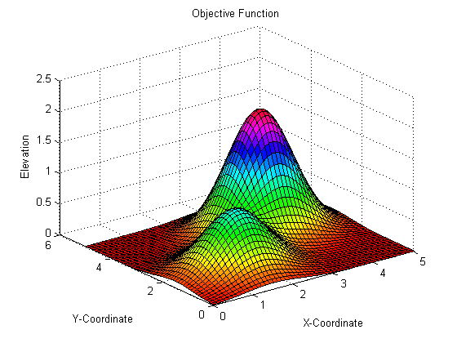
Model specifications
Ensuring that the sampler explores probability space well
Goals
model <- jags.parallel(data = jags_data, model.file = model_file,
parameters.to.save = parms,
n.chains = 3,
n.iter = 10000,
n.burnin = 1000,
n.thin = 1,
n.cluster = 3)
1. Explore probability space well
2. Find global probability maximum
3. Don’t get stuck in local maximum
Adjustments that can affect sampling performance include
Number of chains
Number of iterations
Burn-in

Slide 55
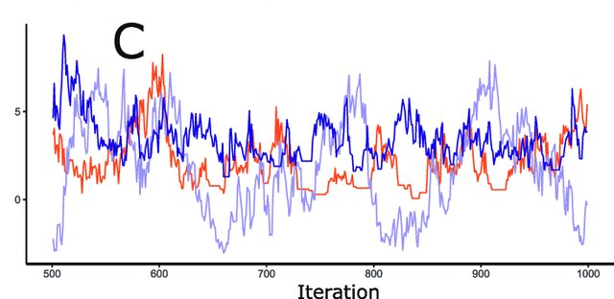
Number of chains
Running multiple chains lets us cross-check them
If they end up in completely different areas, we have a problem
Running a single chain is useful for debugging
For analyses we should always run multiple (commonly 3-4)
But: more chains = slower model

Slide 56
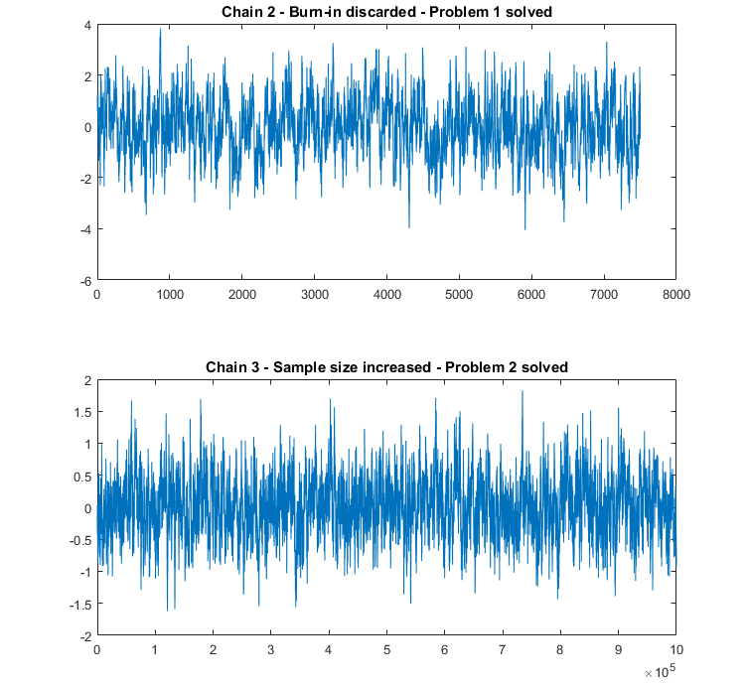
Number of iterations
Number of iterations = number of guesses in each chain
Sometimes the sampler takes a long time to find a region of high probability
Higher number of iterations increases our chance of sampling the posterior well
But: more iterations = slower model
Iteration

Slide 57
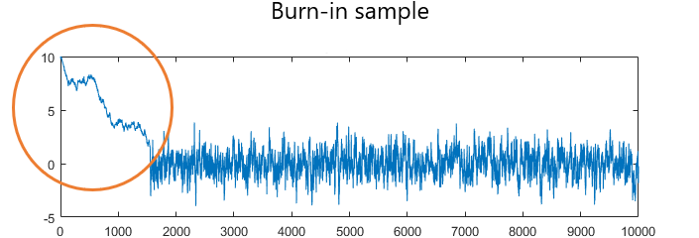
Burn-in
Initial guesses are normally far away from the target distribution
This first part of the chain is colloquially called “burn-in”
We discard these to avoid bias in our estimated posterior distribution
It’s common to discard the first 1000-2000 iterations as a burn-in phase

Slide 58
Model diagnostics

Slide 59
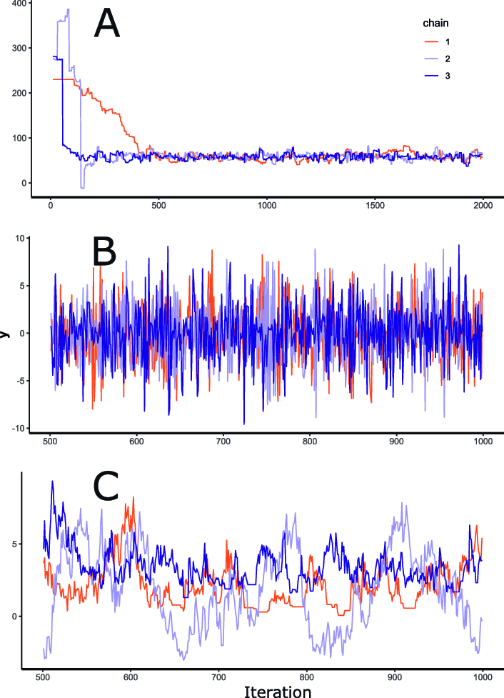
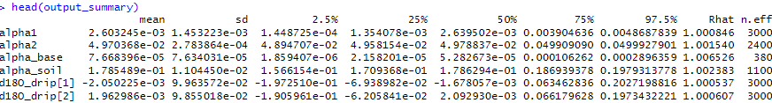
Chain mixing & convergence
By running multiple chains we can check that they converge on the target distribution
They should be well-mixed = explore the same parameter space
We can use trace plots and R-hat convergence measures to evaluate chain mixing
Trace plots
Well-mixed
R-hat convergence measure
Not well-mixed
With higher convergence, R-hat tends to 1
ONLY AN INDICATOR NOT A TEST!

Slide 60
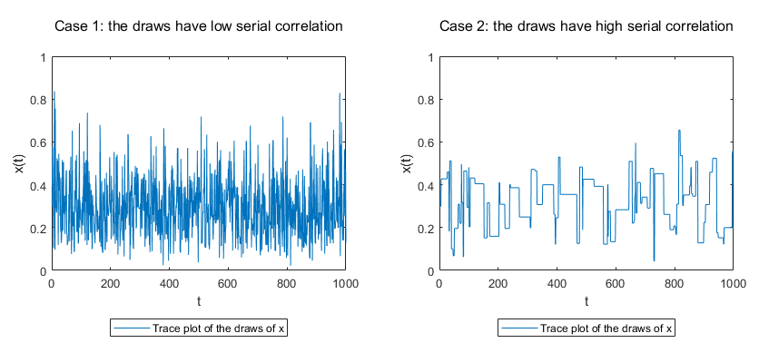
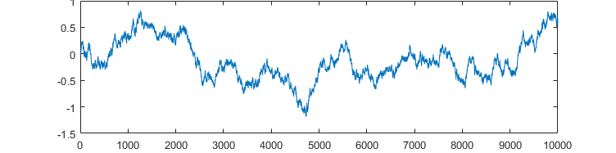
Effective sample size
Parameter guesses in MCMC are serially correlated (autocorrelated)
→ dependent observations
Equate to a lower number of independent observations
If our guesses are highly serially correlated the effective sample size shrinks
We want to minimize serial correlation

Slide 61
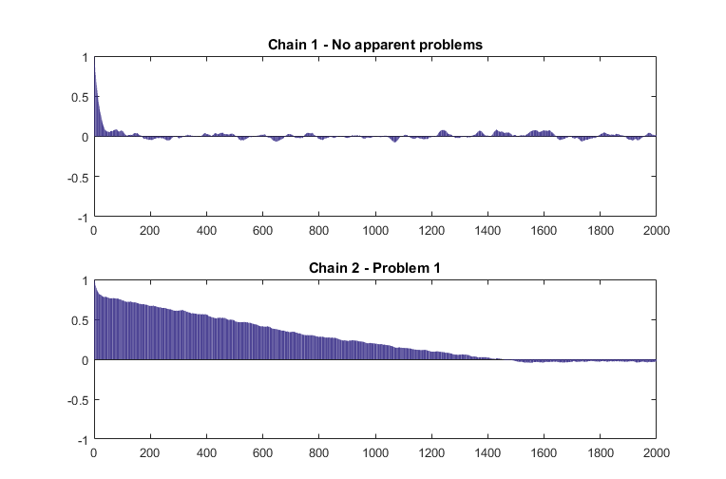
Autocorrelation function plots (ACF)
ACF plots additionally highlight any issues with high serial correlation
Highly autocorrelated chains can indicate that chains are not exploring the whole sample space
Chains may be getting stuck in local probability maxima

Slide 62
MCMC diagnostics
“When you have computational problems, often there is a problem with your model. “
Andrew Gelman

Slide 63
Examining the posterior

Slide 64
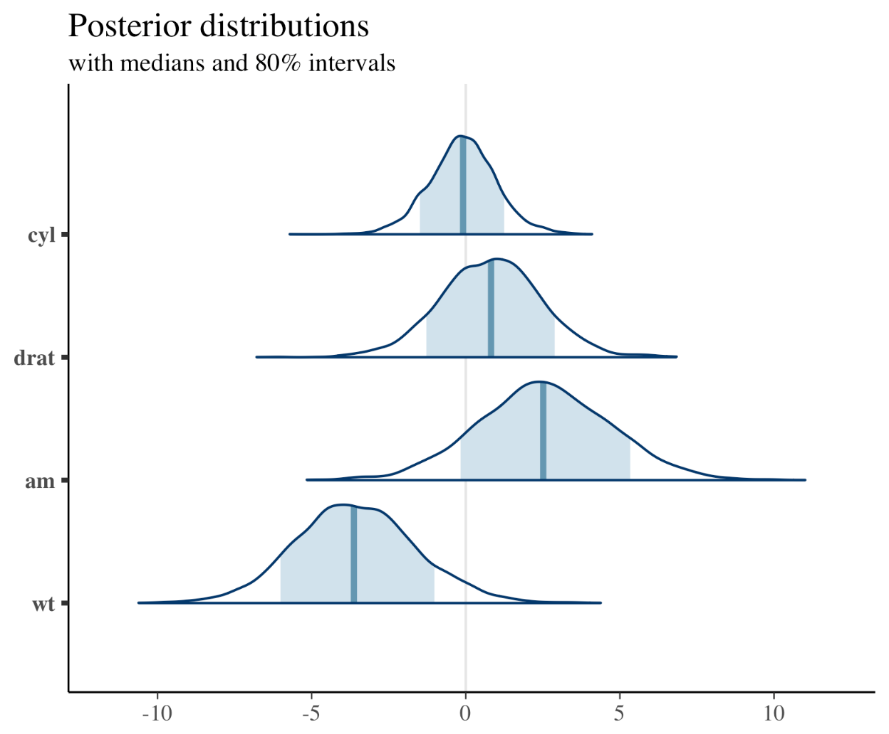
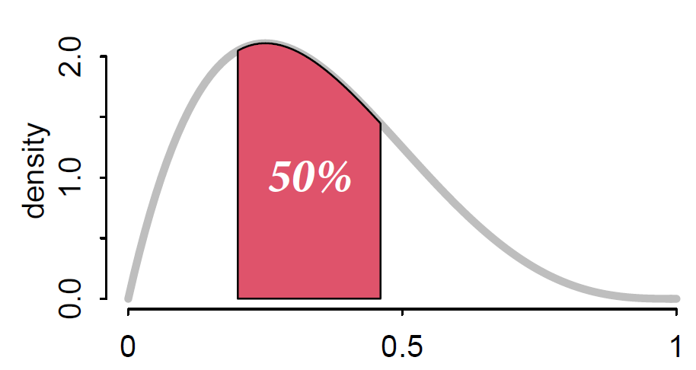
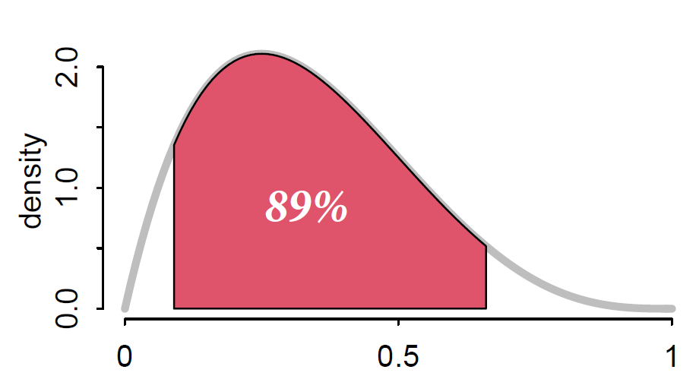
Examining the posterior
The posterior distribution describes our new knowledge about our quantities of interest
The distribution is the estimate!
No point estimates
The shape contains information
We can use descriptive measures
Mean, median, mode
Probability density intervals (credible intervals, highest density intervals)
Intervals are descriptors, there is nothing magical about 95%

Slide 65
Inference

Slide 66
What can we infer?
“Garbage in, garbage out” always applies
Bayesian statistics deduces the implications of the data given the assumptions of the model structure
You must choose the assumptions you think are reasonable
Testing different model structures can help

Slide 67

The end…

